Slide 1
Horror Movie Characters I could beat

Slide 2
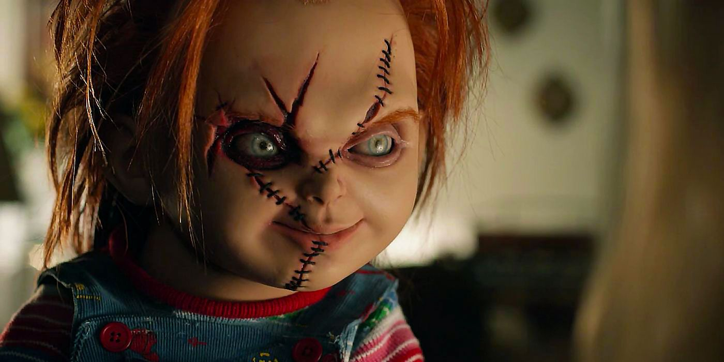
Chucky
Child’s Play

Slide 3
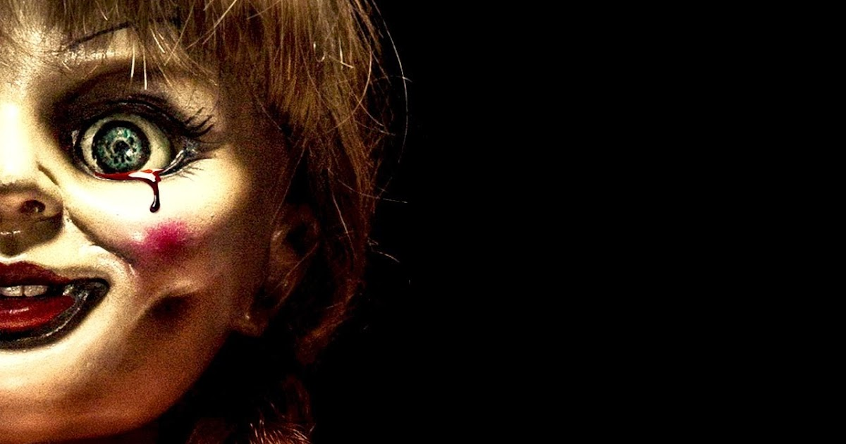
Annabelle
Annabelle

Slide 4
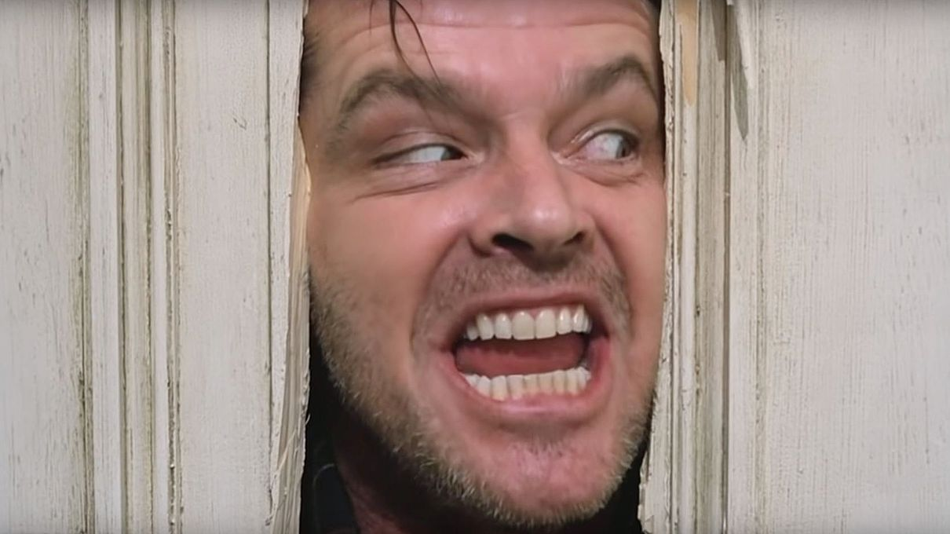
Jack Torrance
The Shining

Slide 5
Jigsaw
Saw

Slide 6
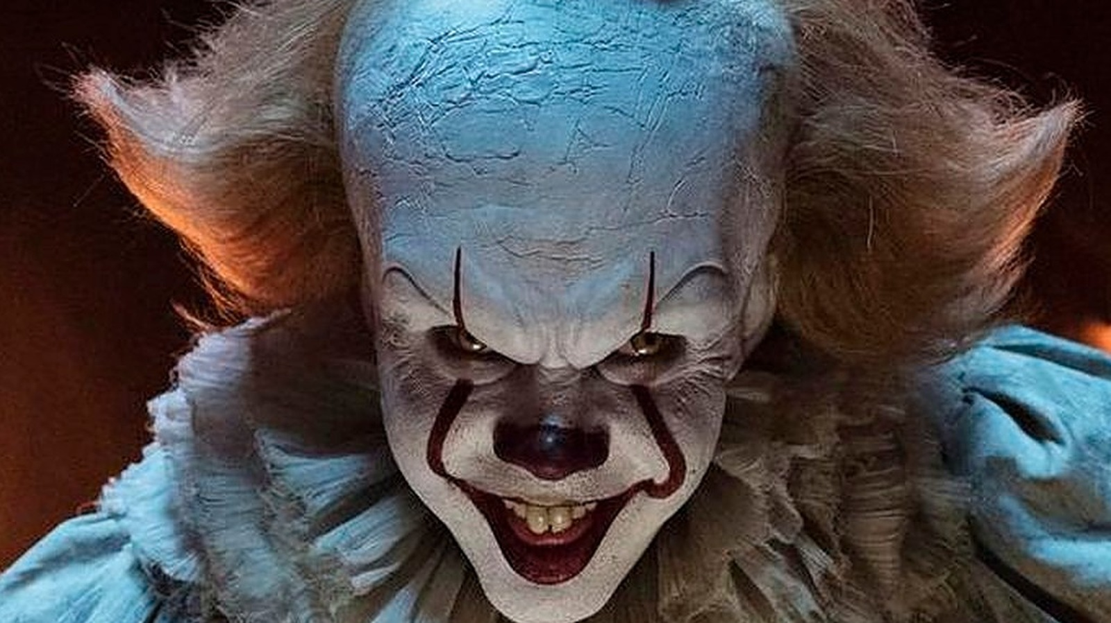
Pennywise
It

Slide 7
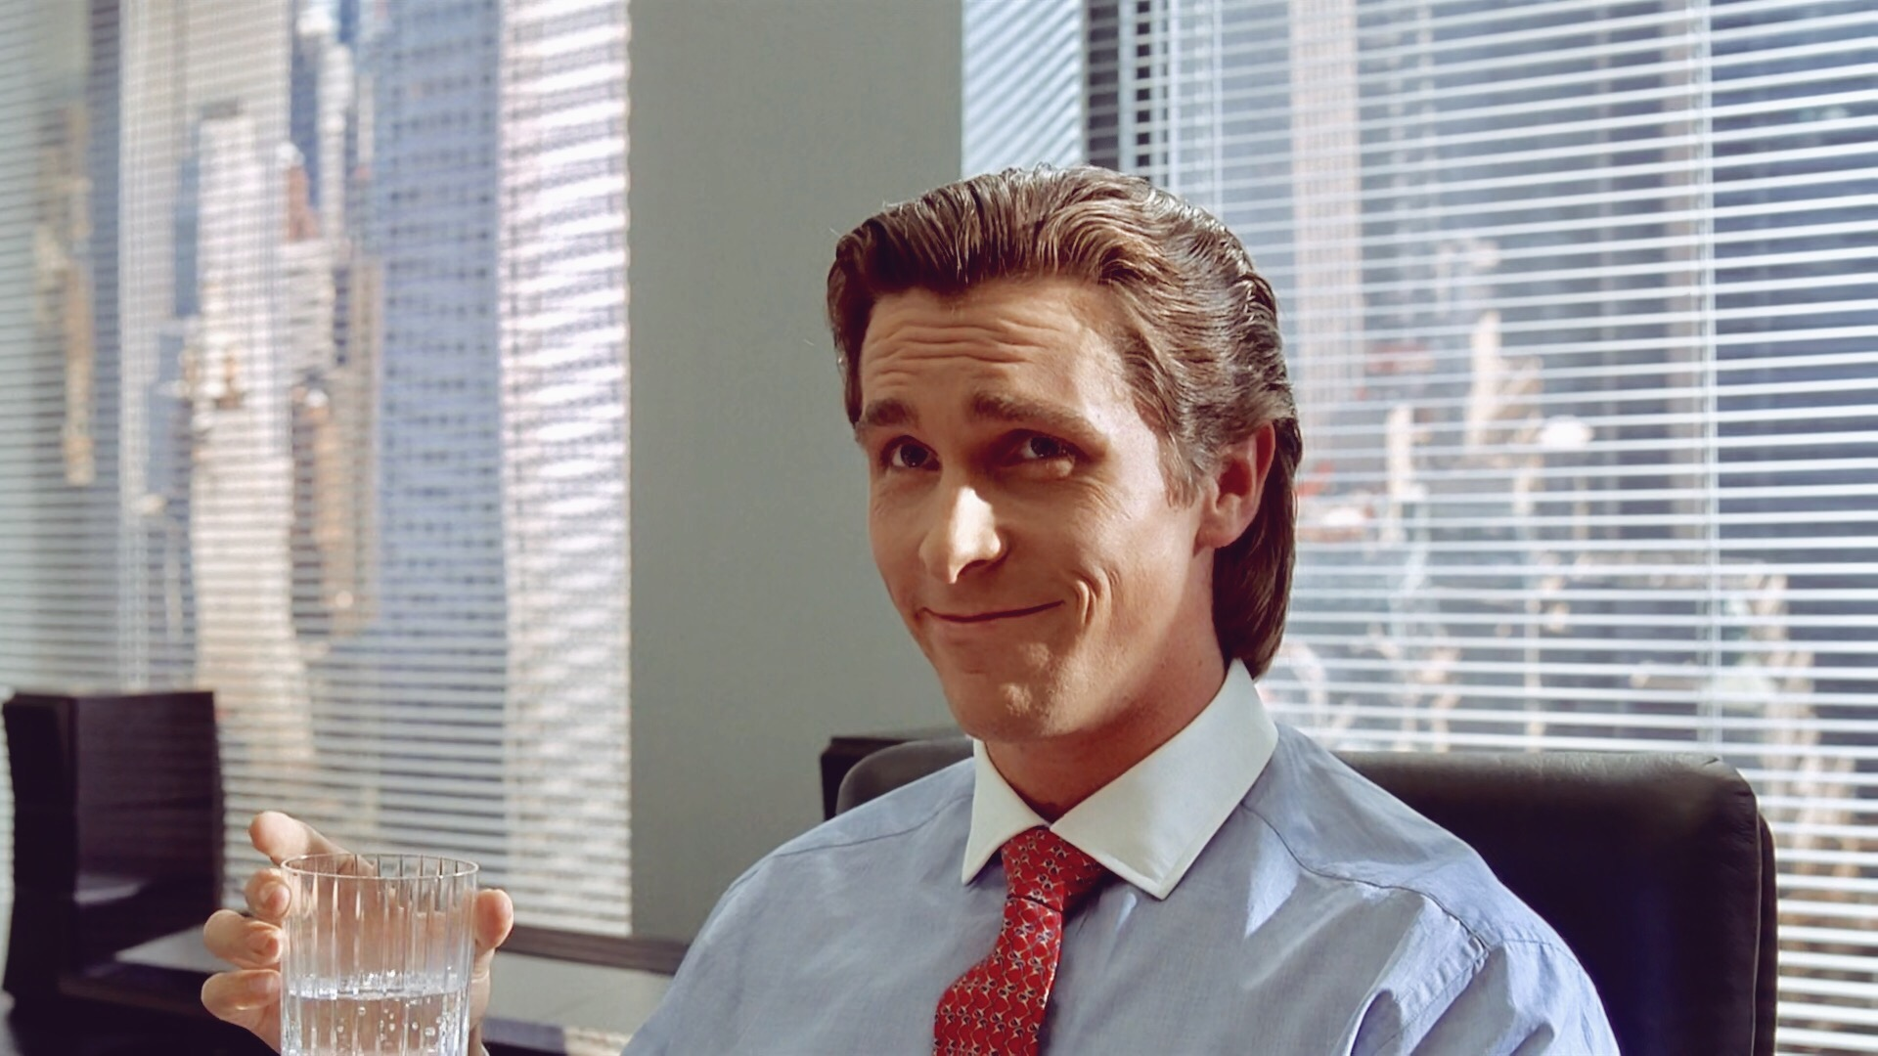
Patrick Bateman
American Psycho

Slide 8
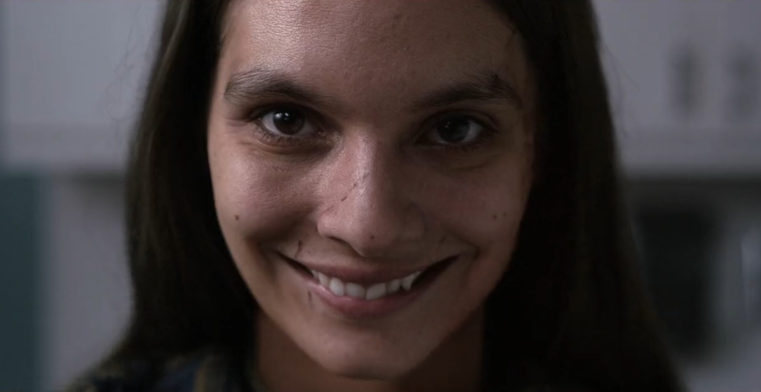
The Demon from Smile
Smile

Slide 9
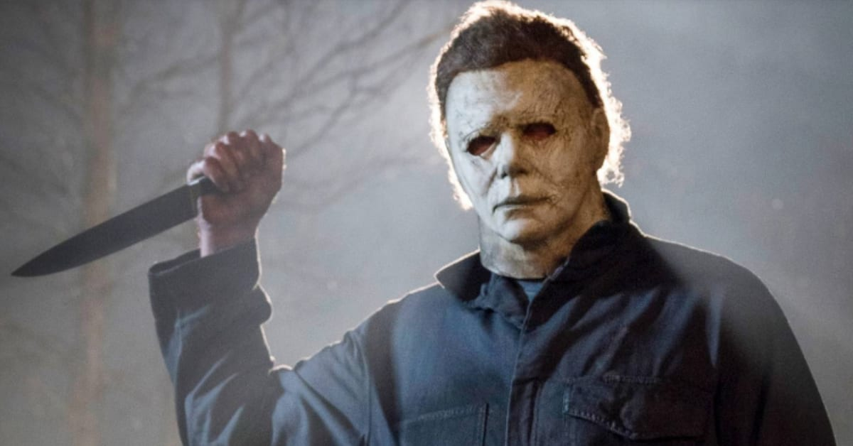
Michael Myers
Halloween

Slide 10
Conclusion
All characters in Horror Movies are stupid and I am stronk af.

